Slide 1



NEOM AI Challenge
King Abdulaziz University
University representative
Dr. Adil khadidos
akhadidos@kau.edu.sa
Supervisor
Prof. Maher Khemakhem

Slide 2

Energy Challenge

Slide 3

A DL-BASED OPTIMISATION FOR RENEWABLE ENERGY MIX AT RECORD LOW COST
Forward Looking team

Slide 4




Team members
Abrar Alkhamisi
Junaid Mohammad
Osama Younis

Slide 5

Team members
Ulaa Al-Haddad
Zaakki Luthufi

Slide 6






Introduction
NEOM
More than just a smart City
State-of-the-art-Project
Mega project Powered by AI/R&D/Technological Development
Strategic hub
Location/Trade/Energy/Climate
Completely Powered by Renewable Energy-Greener & Cleaner

Slide 7

NEOM-Energy Hub
NEOM is estimated to garner 72 GW of energy from mixed sources of renewable energy.
Blessed with plenty of solar radiation and optimal temperature, NEOM, presents huge potential in harvesting solar energy.
With Wind speeds averaging about 10m/s, NEOM and moderate temperatures, harnessing Wind energy is crucial to sustainability of NEOM.

Slide 8
Optimization for Energy Mix
SOLAR & WIND Power Generation:
NEOM has unique changing weather patterns
Leads to change in the factors SOLAR & WIND energy generation depend on.
Results in different rates of power generation over a given period.
For Optimization:
Forecasting becomes critical and imperative.
Requires precisely calculated Power generation over a given time period.

Slide 9


Proposed Idea
Weather Data
Energy Consumption Data
Historical Data
Targeted segment
The system is meant to be used by City Administration officials. Specifically, it is to be utilized those in charge of maintaining the stable supply of electricity to NEOM on a regular basis.
Solar
Wind
Forecasting
Using Neural Networks
AI/Machine Learning
Mixed Energy Generation
Formulation for Calculation Metrics
Energy Generation
Evaluation
AI/Machine Learning
Demand v/s Supply
Mobile Application
Accessibility
Visualization
Dashboard

Slide 10

Challenge Areas
NEOM Energy Challenge/Needs:
Driven by optimized energy mix of Solar, Hydro, Nuclear and Geothermal sources. Forecasting driven by AI for generation and consumption needs to be in place.
Optimization
Energy mix should be able to cater to the growing city of Neom to make it sustainable
Scalability
Management & Distribution
Massive Energy Shifts from non-renewable to renewable catering sectors-Residential/Industrial/Transportation would require resource management driven by the innovative technologies like Microgrids and AI.
Solar and Wind Power generation and consumption monitoring needs to be at the core of efficient distribution of energy
Monitoring

Slide 11
Objectives
SOLAR & WIND Power Prediction:
1. Predict Wind & Solar climate in future.
2. Predict Energy generation.
3. Estimation & Prediction of consumption of energy within NEOM city.
4. Calculate / Predict future demand / supply.
Visualize the stats on a Dashboard
Connect the metrics to the Android based Application

Slide 12
Project Methodology
Literature Review
Create Framework
Collect Data & Formulate Equations
Modelling the Data Using Machine Learning
Creating Dashboard
Creating Application

Slide 13






Methodology
NEOM Portfolio
Case Studies
Solar Energy Generation
Wind Energy Generation
Machine Learning Models for forecasting energy
Creating framework of the work/research to be done.
Identifying models to work with.
Identifying tools to be utilised for completion of the project.
identifying data sources and downloading the required historical data.
Identifying time-line.
Distribution of work.
Data cleaning.
Data Normalisation.
Identifying the precise factors for power generation.
Formulating the power generation
Modelling the data for Supervised Learning through Neural Networks.
Forecasting the power generating based on historical data.
Cross validating the results using established the methods.
Reporting the results.
Preparing the data to be connected to the dashboard.
Creating a dashboard for visualisation.
Publishing the data to the dashboard.
Connecting dashboard API to android application.
Testing the system out
Literature Review
Framework
Data Collection & formulation
AI/ML Modelling
Visualization/Application

Slide 14
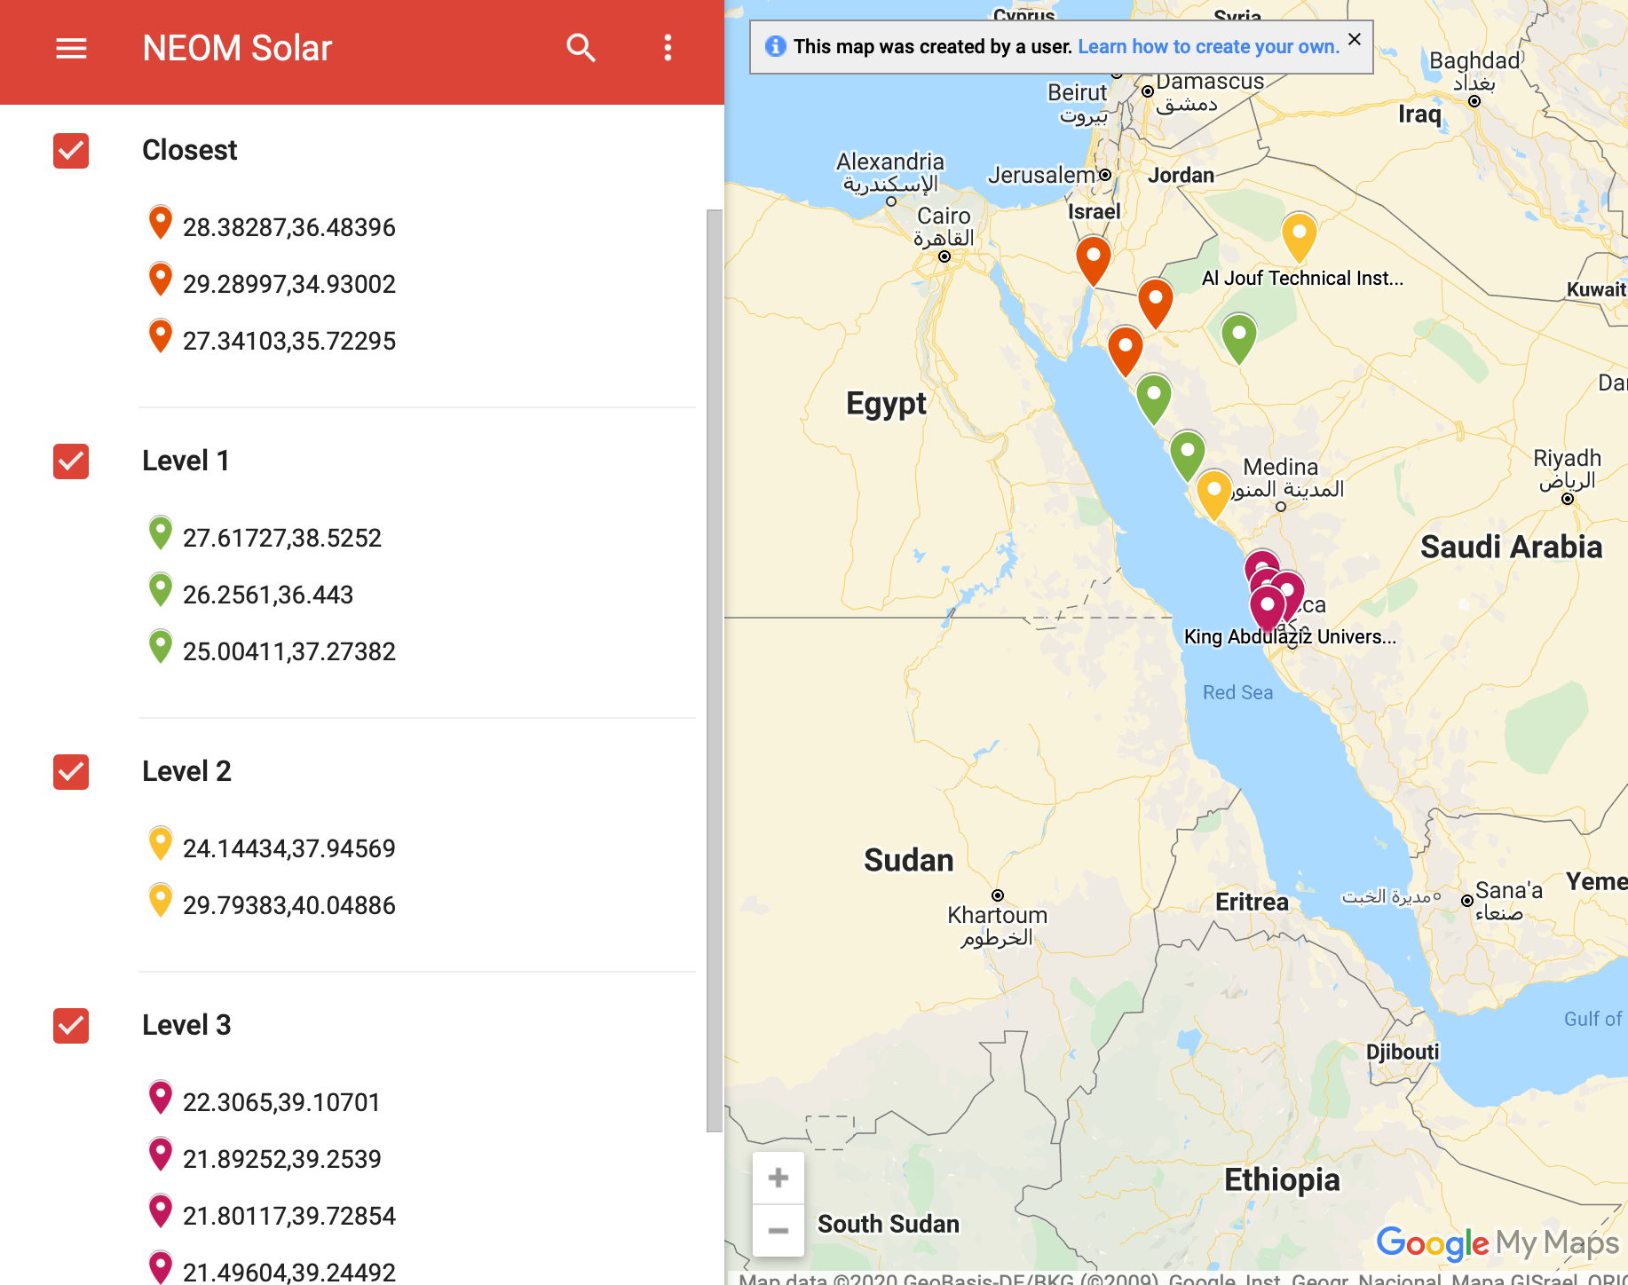
Data Collection
NEOM Solar
Use data from source - Renewable Resource Atlas (https://rratlas.energy.gov.sa/)
Find out locations of Solar panel data collection centers'
Filter out and find locations closer to the NEOM area. Create a map detailing levels in terms of closeness to NEOM
Combine Closest + Level 1 + Level 2 + Level 3 together based on required data points to train Neural Network
Calculate Solar energy generated
Solar Stations Mapped to NEOM

Slide 15
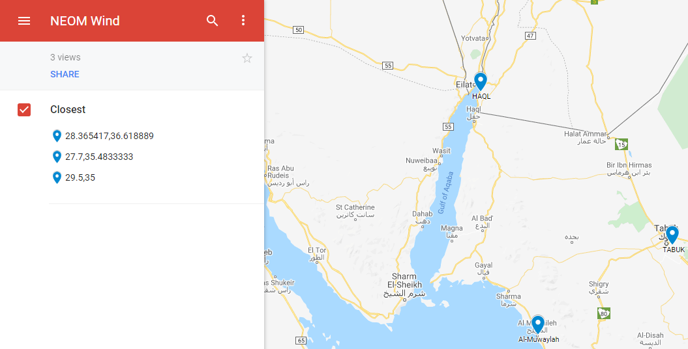
Data Collection
NEOM Wind
Use data from source - Renewable Resource Atlas (https://rratlas.energy.gov.sa/)
Filtered the data for the stations closer to NEOM.
Normalization and Null values were handled.
Mapped the location to NEOM area.
Calculate Wind energy generated for each station

Slide 16

Formulation
Swept Area
Wind Energy
Propeller Blade
P = π/2 * r² * v³ * ρ * η
one watt is calculated as 1 W = 1 kg * m² / s³.
Nacelle containing generator
Radius Blade
Tower
Radius r (metres),
Wind speed v (metres per second),
Air density ρ (kgm3),
Efficiency factor η (%),
Power P (kilowatts)

Slide 17
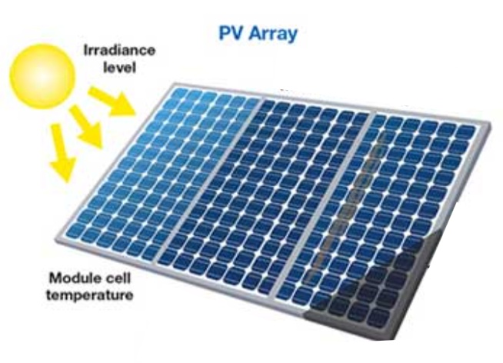
Formulation
Solar Energy
Energy output (kWh/month) = SOLAR ARRAY AREA (m2) x CONVERSION EFFICIENCY x SOLAR RADIATION FOR THE MONTH (kWh/m2/day)

Slide 18
Formulation
Calculating Solar Energy Output
Step 1 - Photovoltaic array area - 0.9906 m * 1.9812 m = 1.9625 m2 (62,000 of this = 15Mw)
Step 2 - Tilt of the array (25.7 degree based on POWER_SinglePoint_Climatology_028d18N_034d85E_44f96c9a.csv)
Step 3 - Determine annual radiation (2361.55 kWh/m2 per year)
Step 4 - Find conversion efficiency (16.3%)
CAPACITY (kW DC) = (1 kW/m2) x (1.9625 m2) x 16.3% = 0.3198875 kW DC
CAPACITY (kW AC) = 0.3198875 kW x 95% = 0.303893125 kW AC
Step 5 - Effect of temperature (At standard 25 degree temperature, efficiency is 16.3%)

Slide 19
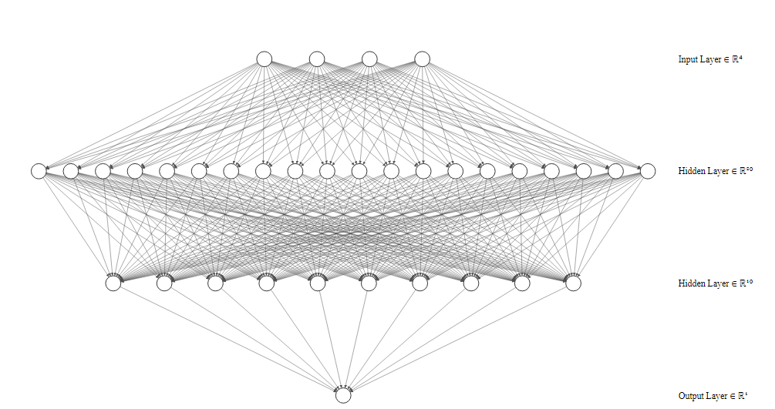
Neural Network Architecture
The architecture is made up of 1 input layer, 2 hidden layers and 1 output layer. The input layer has 4 neurons while the hidden layers have 2000 and 1000 layers respectively.

Slide 20
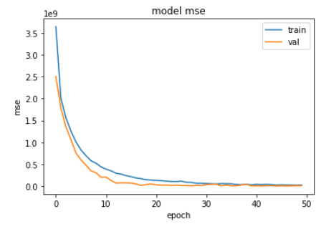
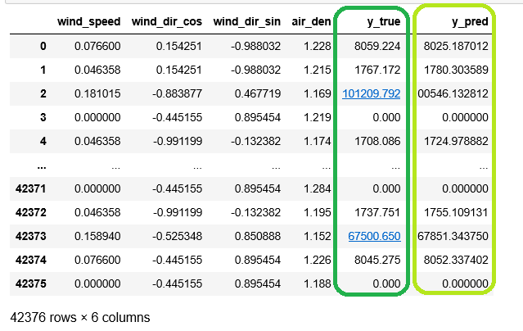
Wind Prediction Model Results
The fact that the MSE is dropping with the epochs is a good sign. It shows that there are less extreme/outlier data points. The model is only off by a small factor which is acceptable.

Slide 21
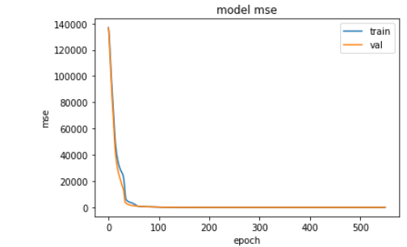
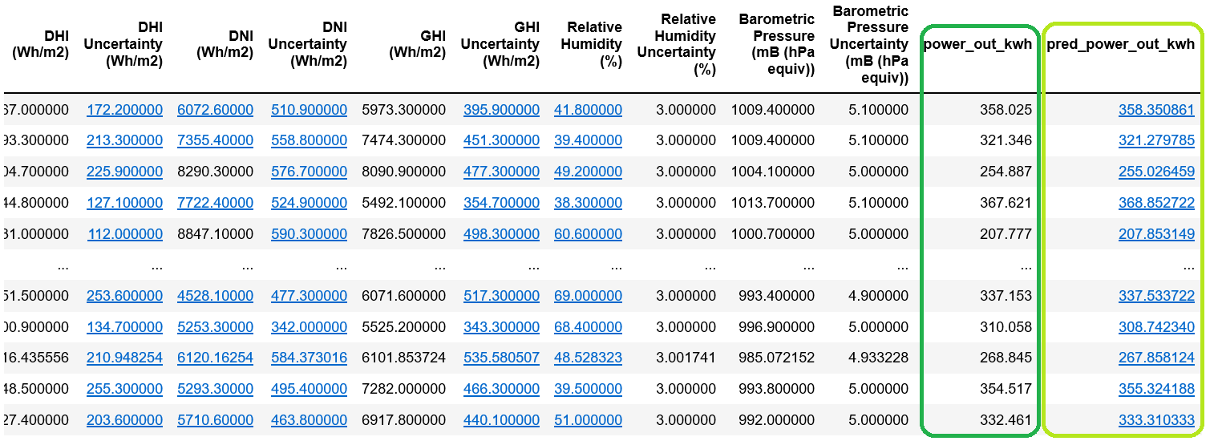
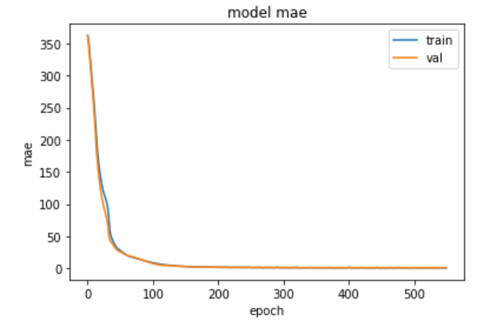
Solar Prediction Model Results
Same as the results of Wind Prediction Model, the MSE here is dropping with the epochs which means there are less extreme/outlier data points. The model is only off by an acceptable small factor.

Slide 22
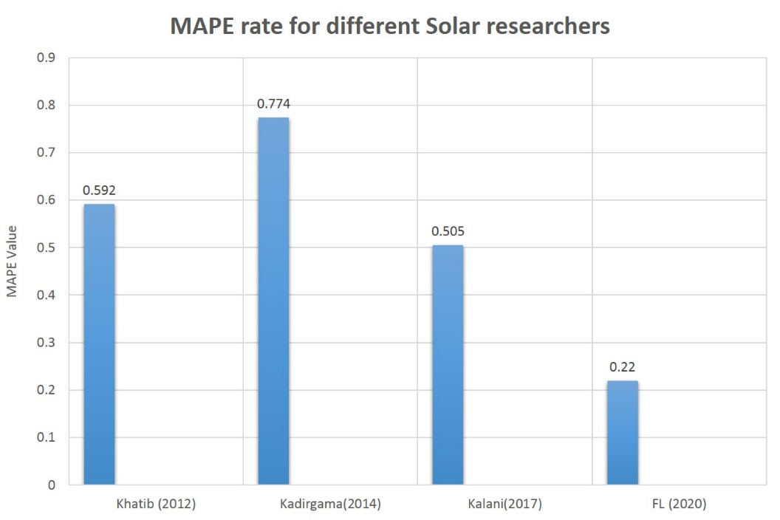
Comparison of Accuracy Results of Related Researches works in solar energy production
Reference No. | Location | Latitude/longitude | ANN/Solar Method | Variables | Finding
(T. Khatib, A. Mohamed, M. Mahmoud 2012) | Malaysia Kuala Lampur Alor Setar Johor Bharu Kuching Ipoh | 3.1390N/01.6869E 6.1248N/ 100.3678E 1.4927N/ 103.7414E 1.6077N/ 110.3785E 4.5975N/ 101.0901E | MLPFF/GSR | SR | MAPE: 0.592 RMSE: 7.96 MBE: 0.0146
(Kadirgama, Amirruddin, and Bakar 2014) | Malaysia | 4.2105N/ 101.9758E | SLP-QPA/GSR | TM, RH WS, PRE TIME | MAPE: 0.774 R2:0.989 MBE: 0.026
(Kalani, Sardarabadi, and Passandideh-Fard 2017) | Iran | 29.4963N/ 60.8629E | MLP-LM, RBF, ANFIS/ GSR | TM, SR, RH SH, Rain. | MAPE: 0.5054 R2:0.9906 RMSE: 0.2562
The evaluation results of our solution: MAE: 0.8148574829101562 and MAPE: 0.22775055468082428.

Slide 23
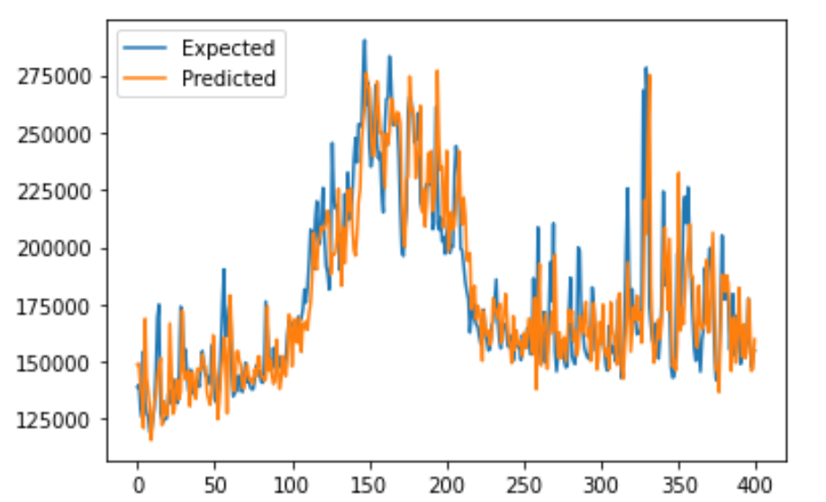
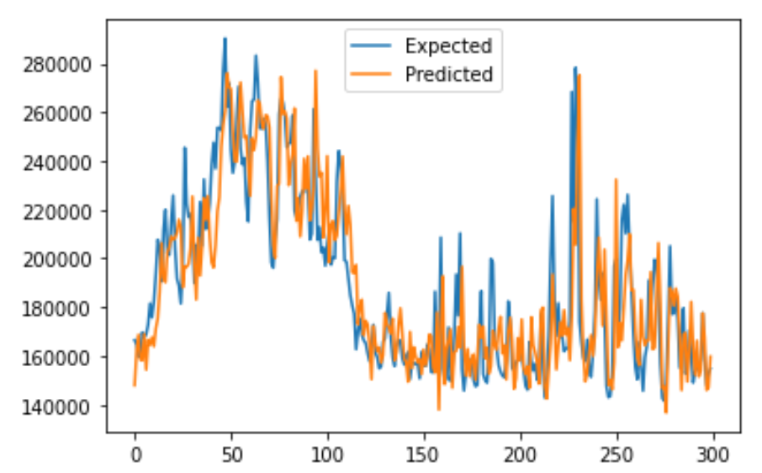
Consumption Prediction Model Results
First Scenario:
Training initially with 465 (865-400) data instances. The MAPE: 0.074360
Second Scenario:
Training initially with 565 (865-300) data instances. The MAPE: 0.077

Slide 24
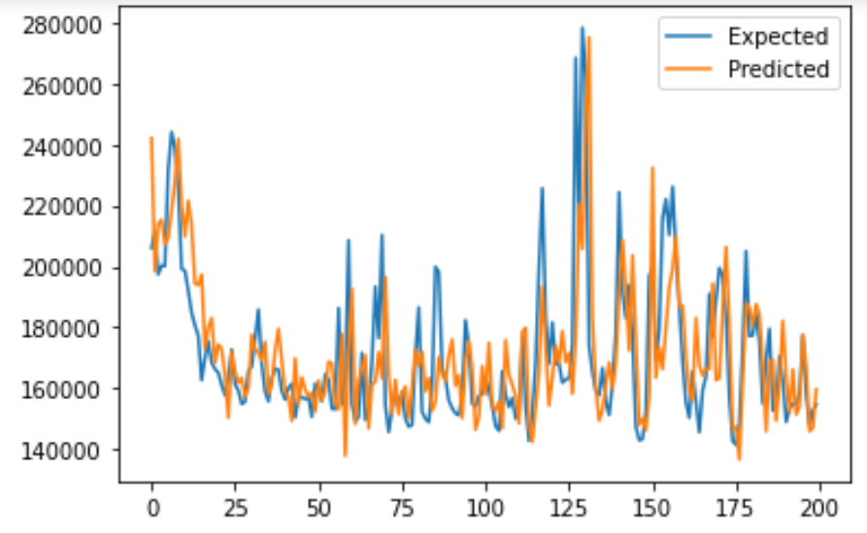
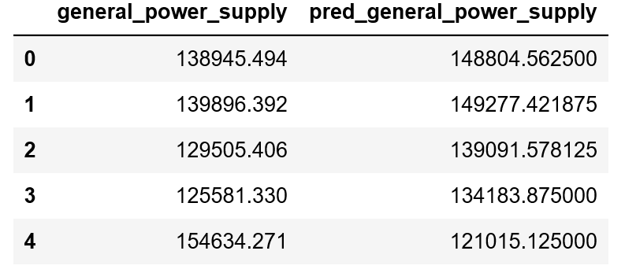
Evaluation of Models Applied
The prediction of general power supply
Third Scenario:
Training initially with 665 (865-200) data instances. The MAPE: 0.078

Slide 25
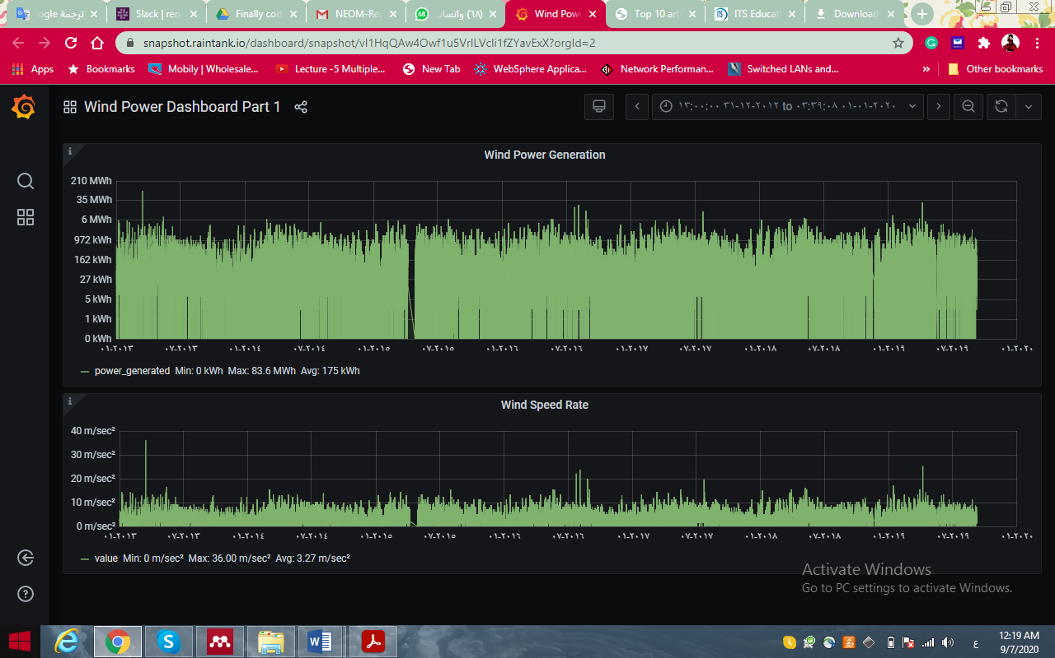
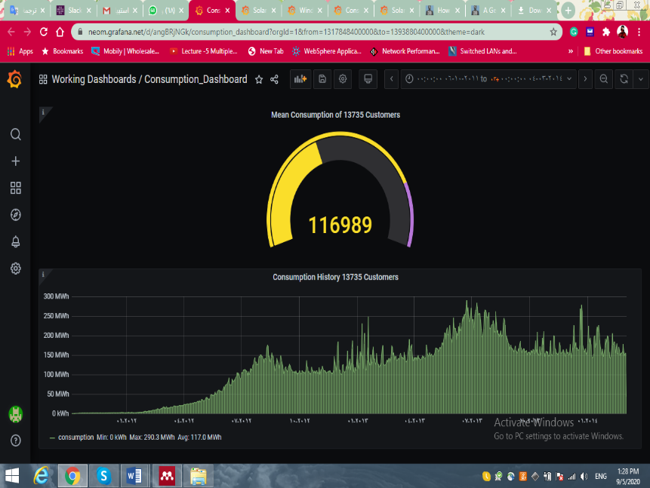
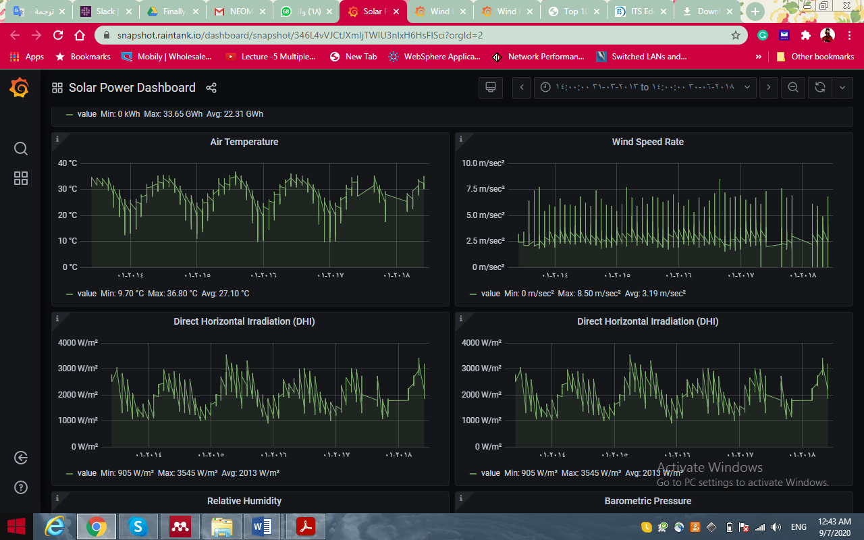
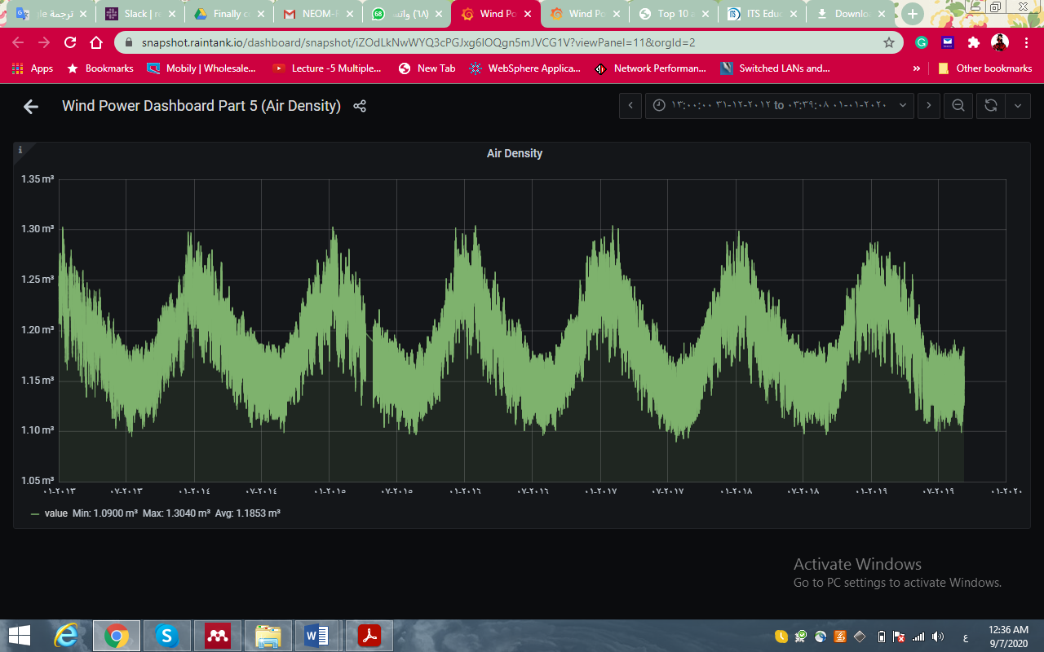
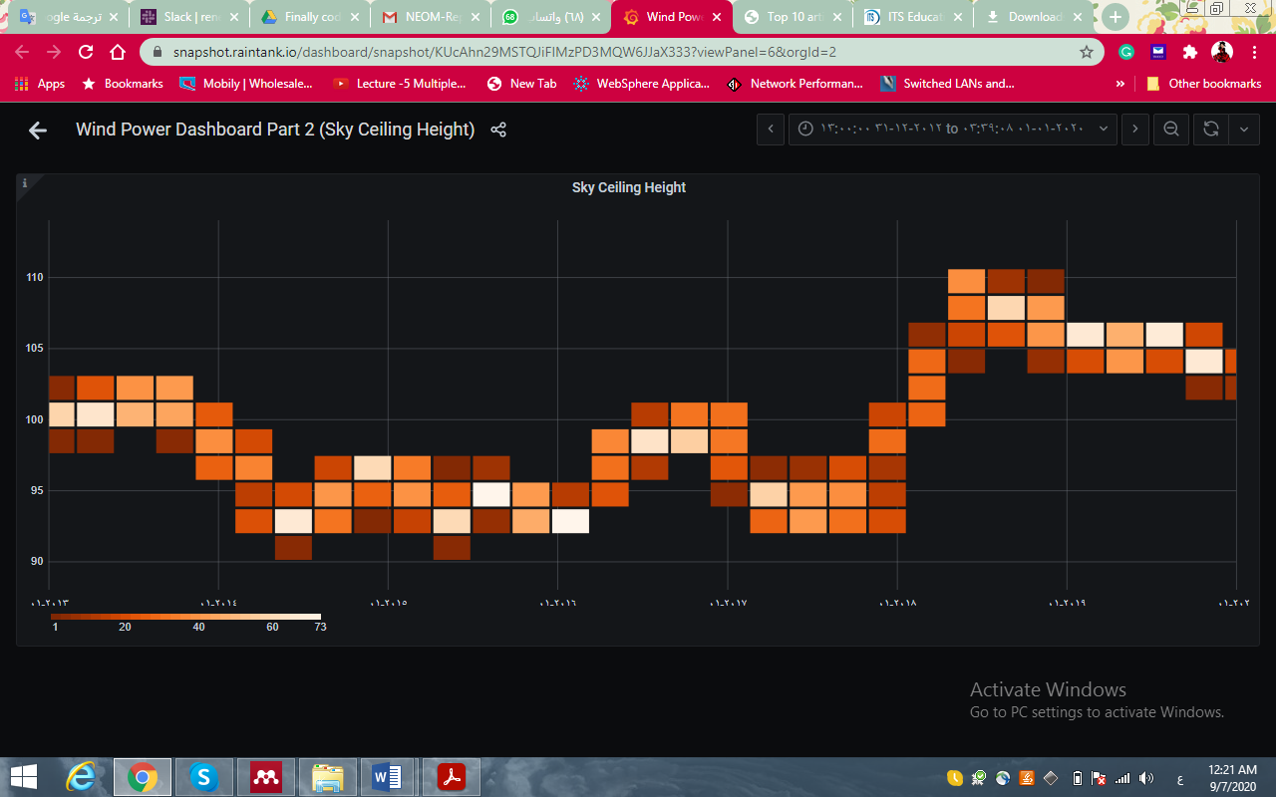
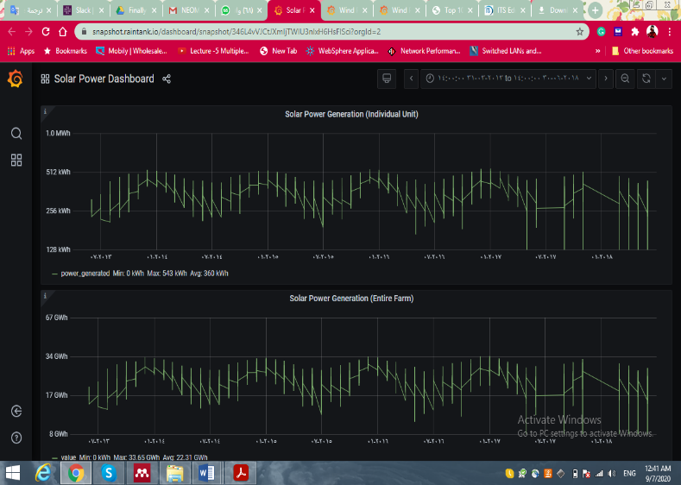
Dashboard
Wind Power Dashboard
Consumption Dashboard
Solar Power Dashboard

Slide 26
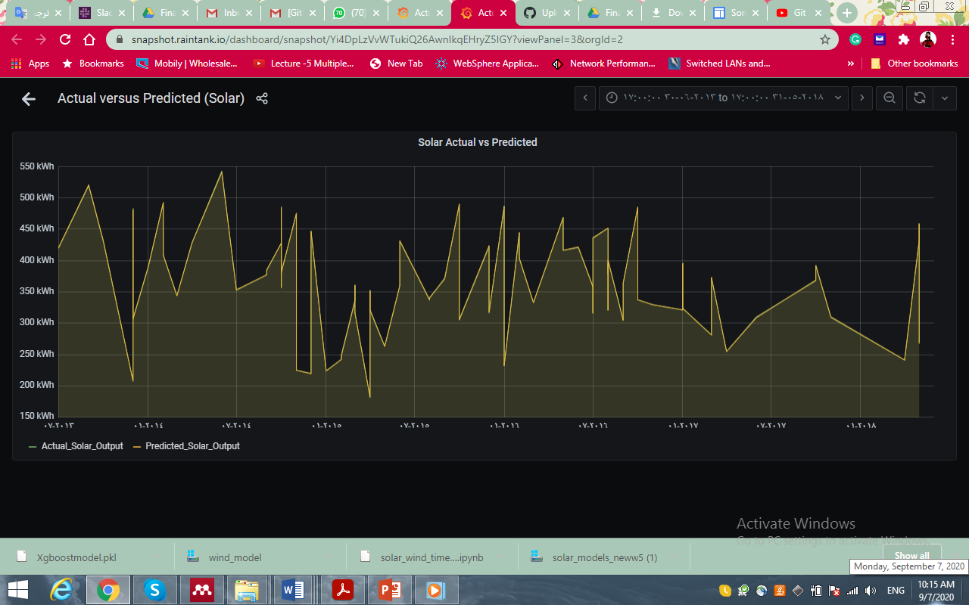
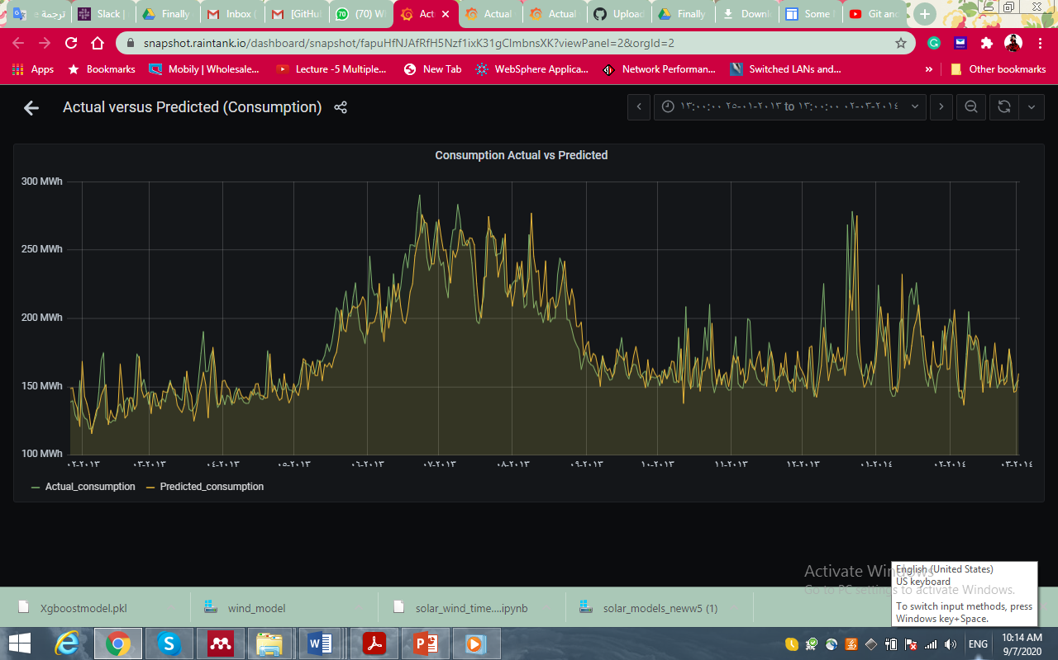
Dashboard
Solar Actual Vs. Predicted
Actual Consumption V.s predicted

Slide 27




What makes our solution stand out from the rest?
Precision
AI Modelling
Formulation
Simplicity
Used data that corresponds to weather conditions of NEOM to best of availability possible.
Mapped all the data to NEOMs geographic location.
Followed Systematic Literature review, to arrive at the model to be applied.
Applied Neural Network to achieve optimal solution.
Thorough review of the equations used to precisely calculate the power generation.
Made sure all dependencies that affect the power generation are accounted.
Equations backed-up by references.
The approach is simple and yet practical with effective solution and minimal cost.
Utilizes the data from the available indigenous base stations.
Approach is scalable
with ease of implementation.

Slide 28



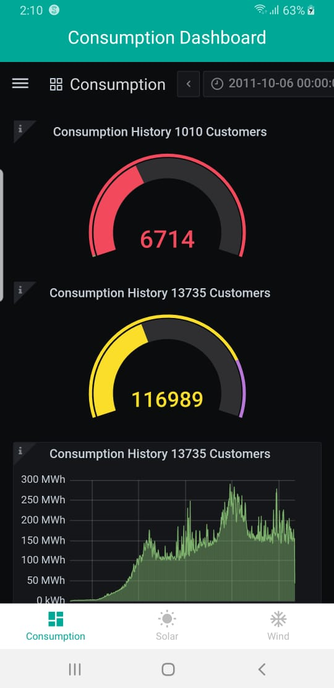
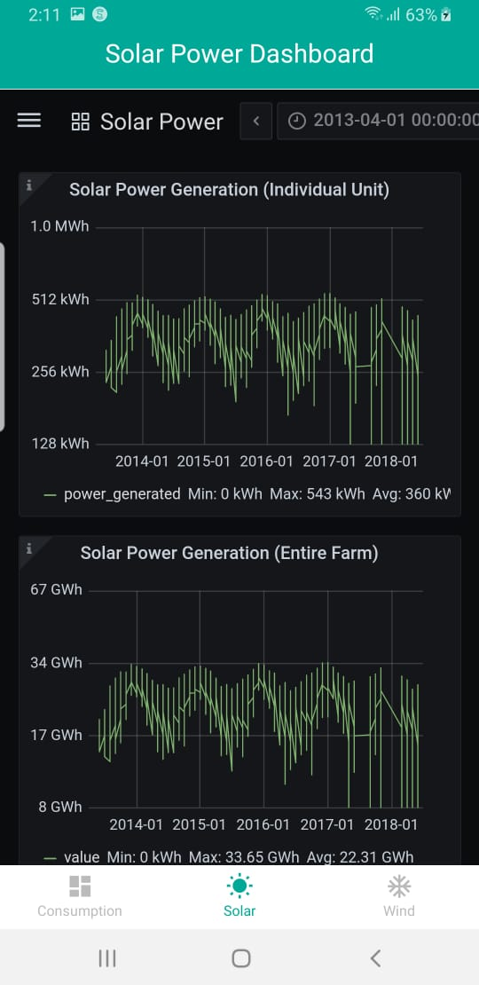
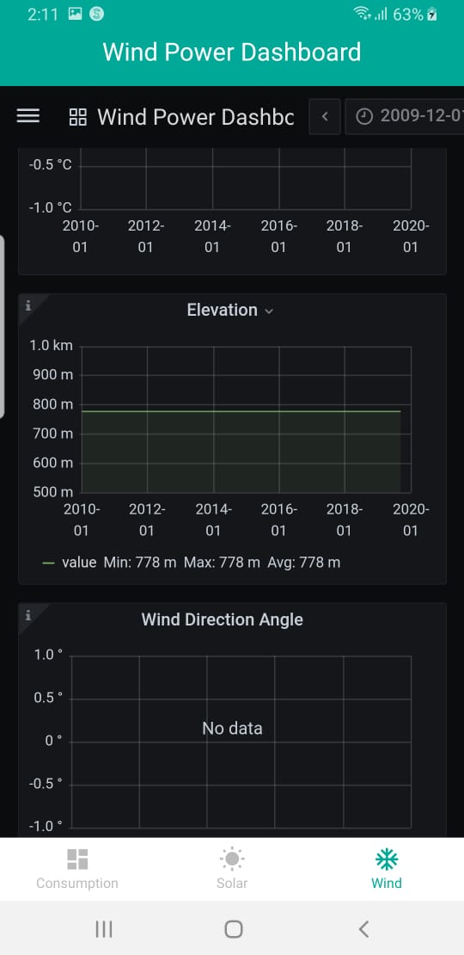
Application

Slide 29
Q & A
RISK & OBSTACLES
Who is going to use our solution in NEOM?
The system is meant to be used by City Administration officials. Specifically, it is to be utilized those in charge of maintaining the stable supply of electricity to NEOM on a regular basis.
Data obtained and storage
Issues of management and responsibility
Computation speed
Weather fluctuation
Why our solution can be implemented in NEOM?
Our solution can be scaled to fit the realistic requirement of NEOM since the data sources are from reliable sources approximated as much as possible for the NEOM geographical area. As long as weather sensors collect data accurately in NEOM when implemented, our solution will be able to continuously provide utility
How we are implementing AI to solve the problem?
The AI models used in this solution have been trained on highly accurate information and can be utilized to predict energy demands. The AI in our solution uses a combination of supervised and unsupervised machine learning techniques and Neural Network architecture to deliver the solution

Slide 30
Related Work
Title(APA Citation) | AI Approach | Limitation
(Laroui et al. 2019) | Deep learning | Energy management of EV in Smart Cities is ignored.
(Marzband, Azarinejadian, and ... 2015) | Artificial bee colony | Emission cost of a dis-patchable micro-turbine is not considered. Complex formulation.
(Arcos-Aviles et al. 2017) | Artificial Intelligence (Fuzzy logic) | Battery degradation is not considered. Only the battery charger/grid connected inverter is controllable.
(Kumar and Saravanan 2019) | Artificial fish swarm optimization | Battery decline cost is not considered.
(Nwulu and Xia 2017) | AI Game theory | Emission cost of traditional generators is not considered
(Mondal et al. 2018) | AI Game theory | Computational complexity is not mentioned.
(Shuai et al. 2019) | Mixed-integer nonlinear programming (MINLP) | Battery lifetime prediction is ignored.
(Chaouachi et al. 2013) | Linear programming | High computational complexity. Cost of battery decline is not Considered
(Taha and Mohamed 2016) | No linear and mixed integer programing | Power wasted and demand are not considered.
(Sukumar et al. 2017) | Linear and mixed integer linear programming | Costs of battery reduction are not considered.

Slide 31
References
Arcos-Aviles, Diego et al. 2017. “Low Complexity Energy Management Strategy for Grid Profile Smoothing of a Residential Grid-Connected Microgrid Using Generation and Demand Forecasting.” Applied Energy.
Brownlee, Jason. 2019. “How To Backtest Machine Learning Models for Time Series Forecasting.” machinelearningmastery. https://machinelearningmastery.com/backtest-machine-learning-models-time-series-forecasting/.
Chaouachi, Aymen, Rashad M. Kamel, Ridha Andoulsi, and Ken Nagasaka. 2013. “Multiobjective Intelligent Energy Management for a Microgrid.” IEEE Transactions on Industrial Electronics.
Jason Brownlee. 2020. “A Gentle Introduction to XGBoost for Applied Machine Learning.” machinelearningmastery. https://machinelearningmastery.com/gentle-introduction-xgboost-applied-machine-learning/.
Kadirgama, K., A. K. Amirruddin, and R. A. Bakar. 2014. “Estimation of Solar Radiation by Artificial Networks: East Coast Malaysia.” In Energy Procedia,.
Kalani, Hadi, Mohammad Sardarabadi, and Mohammad Passandideh-Fard. 2017. “Using Artificial Neural Network Models and Particle Swarm Optimization for Manner Prediction of a Photovoltaic Thermal Nanofluid Based Collector.” Applied Thermal Engineering.
Kumar, K. Prakash, and B. Saravanan. 2019. “Day Ahead Scheduling of Generation and Storage in a Microgrid Considering Demand Side Management.” Journal of Energy Storage.
Laroui, Mohammed et al. 2019. “Energy Management for Electric Vehicles in Smart Cities: A Deep Learning Approach.” In 2019 15th International Wireless Communications and Mobile Computing Conference, IWCMC 2019,.
Marzband, M, F Azarinejadian, and ... 2015. “An Optimal Energy Management System for Islanded Microgrids Based on Multiperiod Artificial Bee Colony Combined with Markov Chain.” IEEE Systems ….
Mondal, Ayan et al. 2018. “DEMANDS: Distributed Energy Management Using Noncooperative Scheduling in Smart Grid.” IEEE Systems Journal.
Nwulu, Nnamdi I., and Xiaohua Xia. 2017. “Optimal Dispatch for a Microgrid Incorporating Renewables and Demand Response.” Renewable Energy.
Shuai, Hang et al. 2019. “Optimal Real-Time Operation Strategy for Microgrid: An ADP- Based Stochastic Nonlinear Optimization Approach.” IEEE Transactions on Sustainable Energy.
Sukumar, Shivashankar et al. 2017. “Mix-Mode Energy Management Strategy and Battery Sizing for Economic Operation of Grid-Tied Microgrid.” Energy.
T. Khatib, A. Mohamed, M. Mahmoud, K. Sopian. 2012. “Estimating Global Solar Energy Using Multilayer Perception Artificial Neural Network.” International journal of energy 6: 82–87.
Taha, Mohamed S., and Yasser A.R.I. Mohamed. 2016. “Robust MPC-Based Energy Management System of a Hybrid Energy Source for Remote Communities.” In 2016 IEEE Electrical Power and Energy Conference, EPEC 2016,.

Slide 32
Thanks for watching ☺

